Slide 1
SVN Seminar
How to use SVN for software version controlling

Slide 2
Outline
What is SVN and why should we use it?
How to setup SVN on your Computer?
How to use SVN?

Slide 3



What is SVN?
SVN or Subversion is a software versioning and revision control system
It is used to maintain current and historical version of files such as source code, web pages and documentation

Slide 4

Why should we use it?
It helps multiple people working on the same software project stay organized
Having a historical record of our source code gives us an easier time for debugging

Slide 5
Why should we use it?
Reverting to a working version becomes very easy (assuming that the current version is buggy)

Slide 6
How to setup SVN on your Computer?
Download “Tortoise SVN” from http://tortoisesvn.net/ and install it on your computer

Slide 7
How to setup SVN on your Computer?
The SVN of UP DEWS is currently being hosted using google code at https://code.google.com/p/up-dews-codes/
We will now have to checkout (or download) the UP DEWS code using SVN

Slide 8
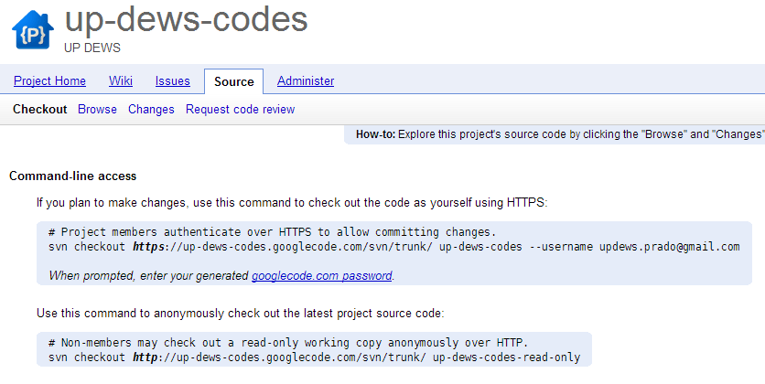
How to setup SVN on your Computer?
Username: Your Gmail Account
Password: Found at google code site

Slide 9
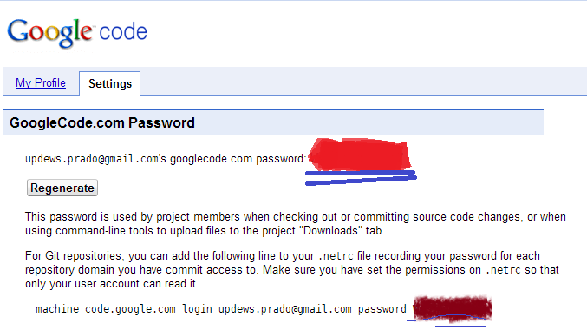
How to setup SVN on your Computer?

Slide 10
How to Use SVN?
Checkout (download codes)
Commit (upload codes)
Update
Show Logs
Revert
Diff

Slide 11
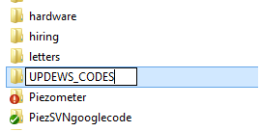
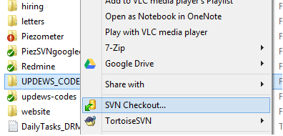
Checkout
Create a new folder and name it “updews_codes”
Right click on the folder and click SVN Checkout

Slide 12
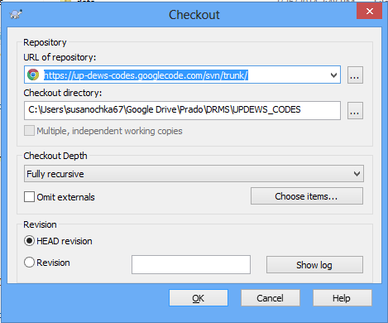
Checkout
Fill out the URL of UPDEWS Repository

Slide 13
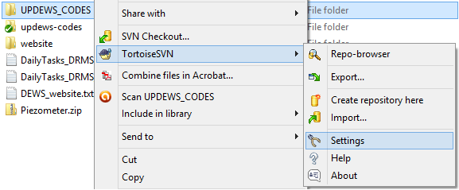
Checkout
We may have to change the proxy settings of our Tortoise SVN to ensure proper Checkout

Slide 14
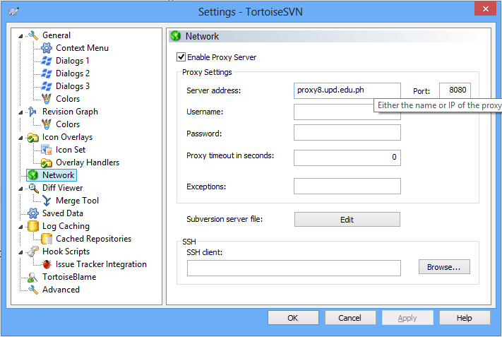
Checkout
Change the proxy settings

Slide 15
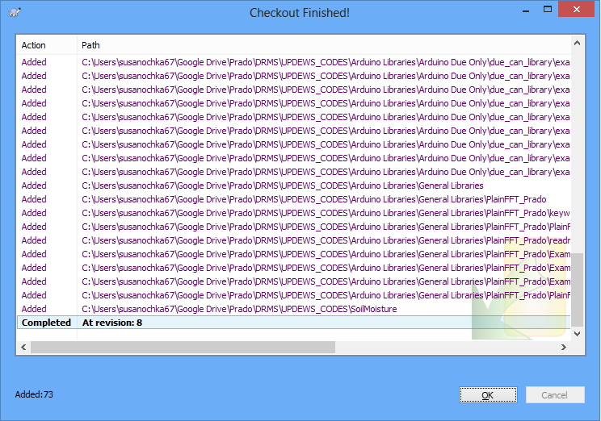
Checkout
You’ll see this if your checkout was successful

Slide 16
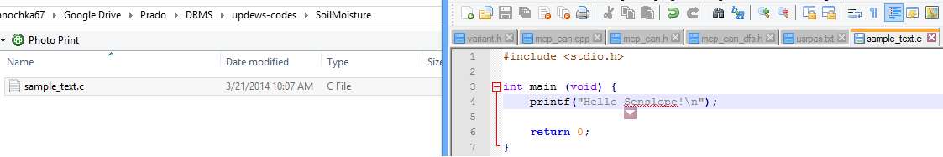
Commit
Let us create a test file for committing
Warning: As much as possible, make sure that the code you are about to commit is working properly

Slide 17
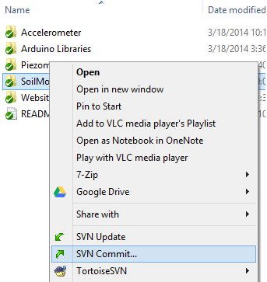
Commit
Right click on the folder & choose SVN Commit to upload your code to the server

Slide 18
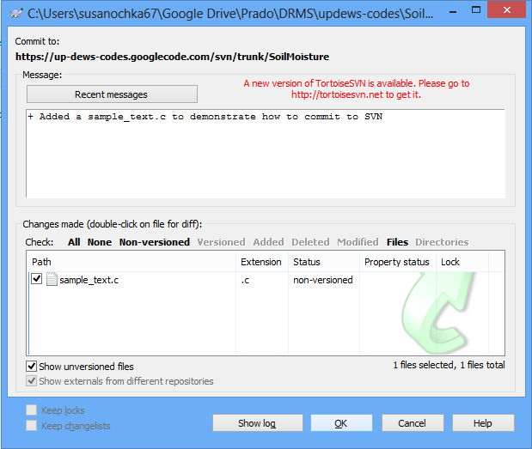
Commit
Here is where you’ll describe the changes that you made for the project.
You can choose files you want committed

Slide 19
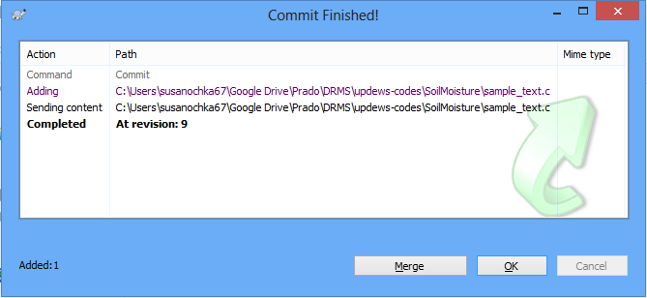
Commit
You’ll see this if your commit was successful

Slide 20
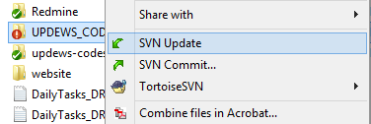
Update
Right click the folder & choose SVN Update to update to the latest revision
Tip: Always Update before Committing to avoid conflicts (very common in Dropbox)

Slide 21
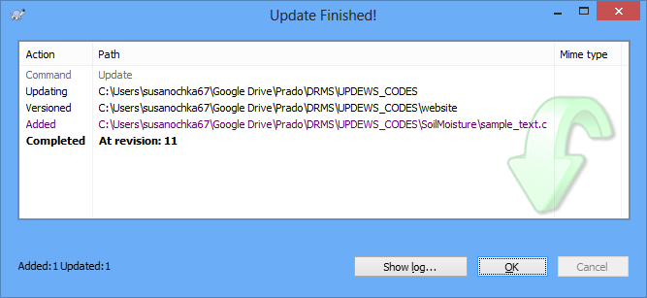
Update
You’ll see this if your update was successful

Slide 22
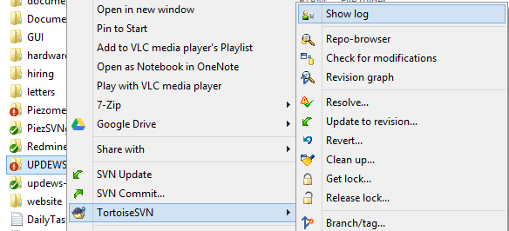
Show Logs
Right click on the folder or item and click Show Log to view its revision history

Slide 23
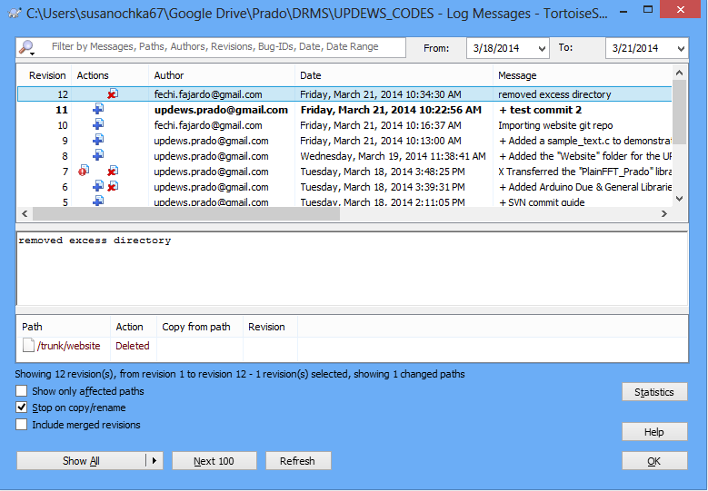
Show Logs
You’ll now be able to view the revision history that can help you debug!

Slide 24
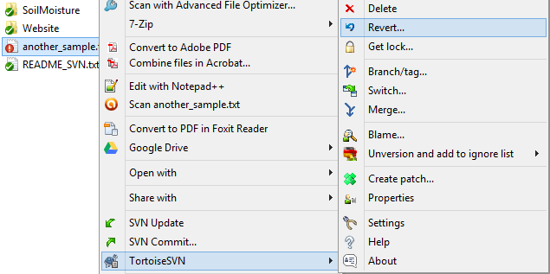
Revert
Right click on the file you want to revert and choose Revert

Slide 25
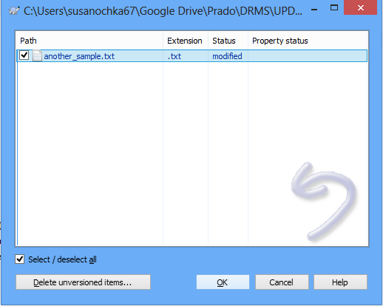
Revert
Select the file/s you want to revert

Slide 26
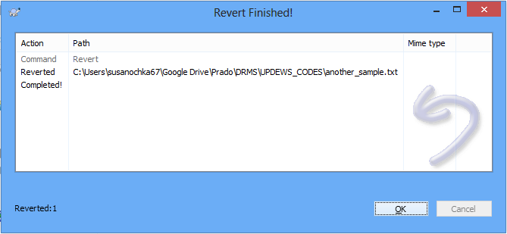
Revert
This is what you’ll see after a successful revert

Slide 27
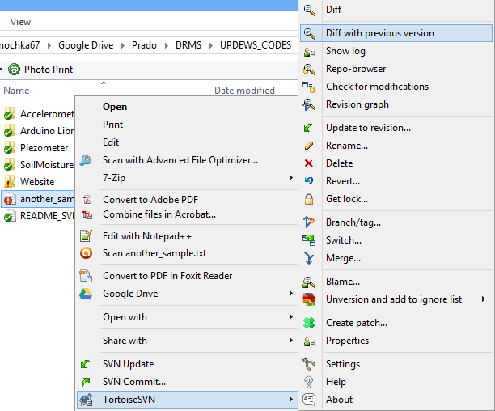
Diff
You can view the exact line changes in a file using diff. This is very useful for debugging.

Slide 28
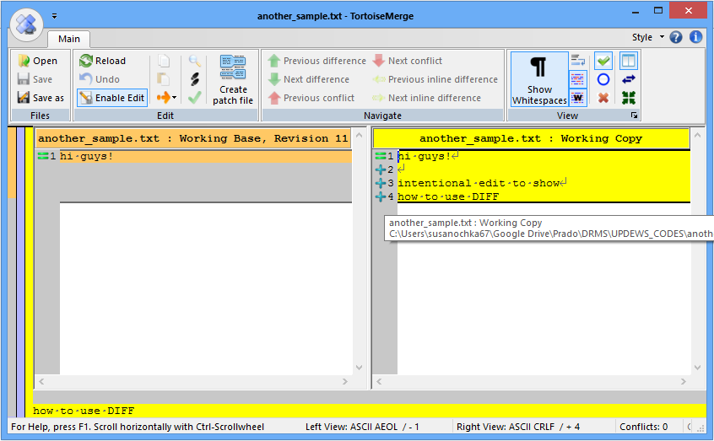
Diff
You’ll be able to view the code differences or choose which lines to merge to the current working copy.

Slide 29
END!!!

